Slide 1
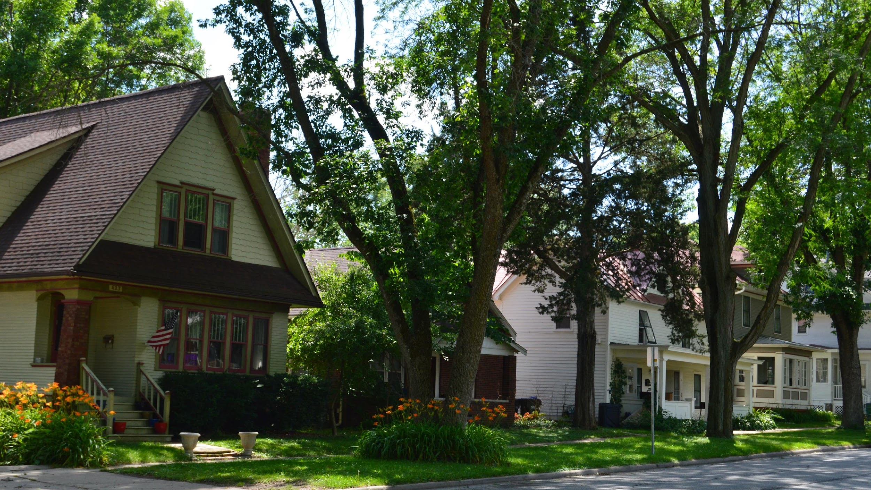
CLEAN ENERGY TRANSITION For non-profits
Community Foundation of Johnson County
Johnson Clean Energy District
Craig Mosher
April 10, 2024
Notes:
Joni and Craig

Slide 2
global climate change lies at the center of OUR work
Wildfires
Drought
Intense rain
Flooding
Tornados – Derechos
Hurricanes
Sea level rise

Slide 3
Energy Transition Underway
Global shift to clean energy sources
Fossil fuels (oil, gas, and coal) replaced with wind, solar, geothermal
Market-driven: Wind cheaper than gas power plants
Solar for homes and businesses
Creating green jobs, local clean energy economies
Notes:
Set scene with big picture of global and home-scale technological revolution now underway.
Abundant, free clean sources (solar, wind, geothermal) replace finite, polluting, and increasingly expensive sources of energy
New ways to heat, cool and power houses that are cleaner and cheaper than old technology

Slide 4
Housing/small business sector
20% of US GHG emissions stem from residential sector + small business
Energy intensity highest in north central US
Average home loses up to 1/3 energy
GHG cuts require combining:
energy efficiency
renewable energy (solar)
renewable generation & grid

Slide 5
Questions
Rent or own your space? Type of space?
What has been done? LEDs, thermostats?
Remodeling? Insulation, windows/doors, appliances, furnaces, A/C
Solar?
Bike racks? EV charging?
Using Inflation Recovery Act (IRA) incentives?
Notes:
1. SSim (1) Simple, Do It Yourself Checklist (2) Energy coaching (3) Professional Audit Make Simple, Quick ‘Repairs to Cracks and Gaps in Walls, Windows, and Doors Prioritize Needed Upgrades and Develop a Multi-Year Plan before Appliances Fail

Slide 6
CAN I HELP (and save money)?

Slide 7
ENERGY EFFICIENCY
Getting same results while using less energy
Cut utility bills & stabilize energy prices
EE can get us halfway to our emission reduction goals
REDUCE BEFORE YOU PRODUCE
Notes:
First… Produce + solar

Slide 8
ENERGY EFFICIENCY SAVINGS
Switching 10 old bulbs to LEDs can save you up to $100 in lighting costs per year – including (80%) fluorescents
Switching to a low-flow showerhead – savings:
$45-$70/person annually on electricity or natural gas costs
Improving insulation, air sealing, and ventilation can save you (EPA est.):
15% on heating and cooling costs
Using fans > A/C including exhaust fans

Slide 9
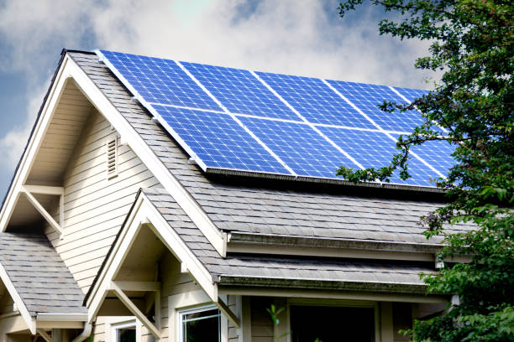
Check Out renewable energy
Roof: orientation, shading, age
$15,000 cost
– 4,500 IRA 30% tax credit
$10,500 Investment
Pay off in 8-10 year “payback period”; then free energy
Notes:
Third…

Slide 10
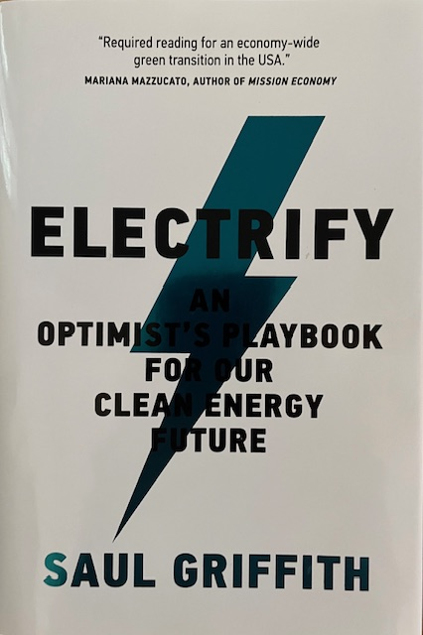
ELECTRIFY EVERYTHING
Replace aging: water heaters, furnaces, A/Cs, stoves, and cars with energy efficient electric models – over Inflation Reduction Act (IRA’s) 10 years
Generate electricity with wind & solar Johnson County’s new 50 A solar field
Expand & upgrade electric grid – for electric homes, EV charging, AI servers
Notes:
Second…
Emphasize 10 year plan

Slide 11
How do we pay for all this?

Slide 12
Costs of EE upgrades
High efficiency appliances and products frequently cost more upfront
Two price tags
Purchase price
Monthly utility bill for next 20 years
Use Energy Star Products page to find products, guidance on models, comparisons, rebates & incentives, where available near you
Notes:
Heating and Cooling, Appliance (Washers and Dryers, Freezers, Refrigerators, Stoves), Water Heaters, Lighting, Windows and Doors, Office Equipment, Electronics, even your pool pums. Certainly your EV charger!

Slide 13
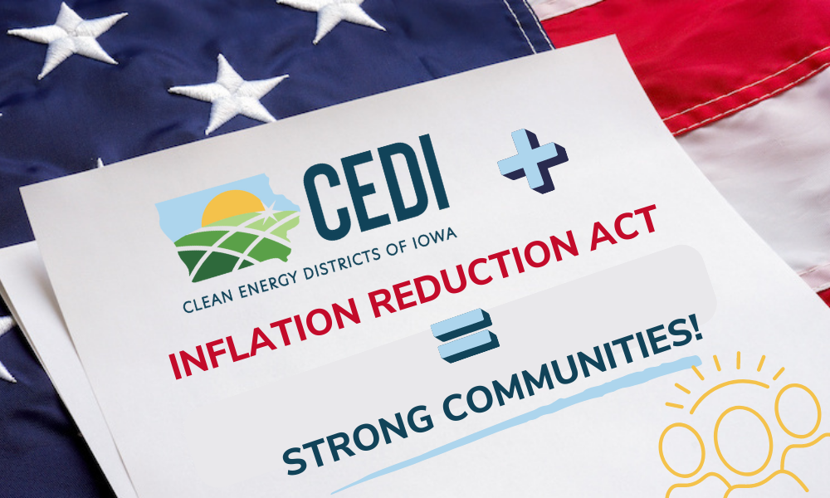
INFLATION REDUCTION ACT
Ten year (2022-2032) federal program to help pay for energy efficiency and renewable energy projects
30% tax credits or direct payments to:
Individuals – credit on income tax
Businesses – tax credit
Non-profits – direct pay
Local governments, – direct pay
Low-income households – rebate program in late 2024
80% for 2=$70,000, 4=$87,000

Slide 14
What is covered by ira?
Residential and non-profit energy efficiency upgrades
Insulation, doors/windows
Appliances (heat pump water heater, furnaces/air conditioner, dryer, stove)
Must be energy efficient certified (keep paperwork!)
30% tax credits, annual limits ($1,200 for home improvements; $2,000 for some appliances), repeatable every year
$150 toward cost of energy audit
Notes:
When applying for utility rebates for high efficiency appliances, pay attention to the requirements. An Energy Star rating is often the criteria used to be eligible for the rebate rather than just a High Efficiency model.

Slide 15
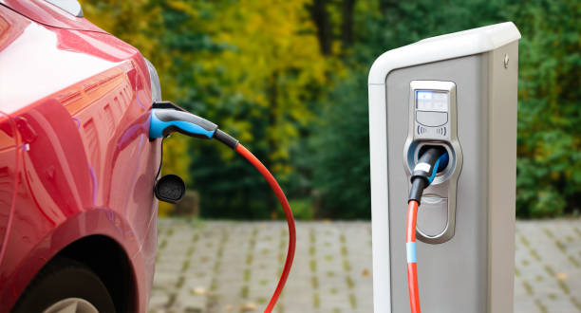
INFLATION REDUCTION ACT
Electric Vehicles and qualifying plugin Hybrids
New: $7500 tax credit – 2024 point of sale – made in US
Example: Chevy Bolt $26,500 —> $19,000
Price <$55,000
Income cap $300,000 (married)
Used cars: $4,000 tax credit; must be:
one owner, >2 years old, dealer, <$25,000
Credit available at point of sale in 2024

Slide 16
EQUITY
Energy Cost Burden
3.5% is national average
16-20% LMI households
Health Impacts
Air Quality
Environmental burden
Extreme weather
Older, drafty homes

Slide 17
How to get started?

Slide 18
Learn about your home Energy Use
Simple, Do It Yourself (Brochure & Checklist) Do simple quick repairs
Energy Coaching – JCED home visits by energy coach
Notes:
1. SSim (1) Simple, Do It Yourself Checklist (2) Energy coaching (3) Professional Audit Make Simple, Quick ‘Repairs to Cracks and Gaps in Walls, Windows, and Doors Prioritize Needed Upgrades and Develop a Multi-Year Plan before Appliances Fail

Slide 19
DIY HOME/BUSINESS ENERGY ASSESSMENT
Energy Efficiency Assessment Tools
To Do list – to begin
Start with LED bulbs, showerheads
Pipe/Duct insulation, thermostats
Basic Energy Efficiency Checklist
More detailed: insulation, windows, air sealing, furnace & A/C, appliances, EVs

Slide 20
Consider solar power
Casey Cook
Has assisted agencies to install solar
Investment and Production Tax Credits
Notes:
1. SSim (1) Simple, Do It Yourself Checklist (2) Energy coaching (3) Professional Audit Make Simple, Quick ‘Repairs to Cracks and Gaps in Walls, Windows, and Doors Prioritize Needed Upgrades and Develop a Multi-Year Plan before Appliances Fail

Slide 21
JCED Energy Coaching Program
Energy Coach performs a free comprehensive home energy audit and reports to homeowner
Coach and homeowner evaluate upgrade priorities, options, and calculate savings over time
Coach answers questions related to IRA incentives and finding and working with contractors
JCED assessments and coaching are free during pilot phase b/c County grant

Slide 22
Meet Craig and Eric Streed
Father and son team with 40+ years experience in Johnson County real estate
Professional home inspectors and home construction contractors
In-depth knowledge about building construction, HVAC, and other energy-related issues

Slide 23
LEARN All YOU CAN
Good Energy newsletter, JCED website, energy breakfasts
Johnsoncleanenergydistrict.org
US Dept. of Energy websites
Appliance comparisons
Financial incentives
Guidance on household energy management
EnergySaver.gov
EnergyStar.gov
Iowa Environmental Council
Iowa Energy and Infrastructure Funding Hub
IAFederalFunding.org

Slide 24
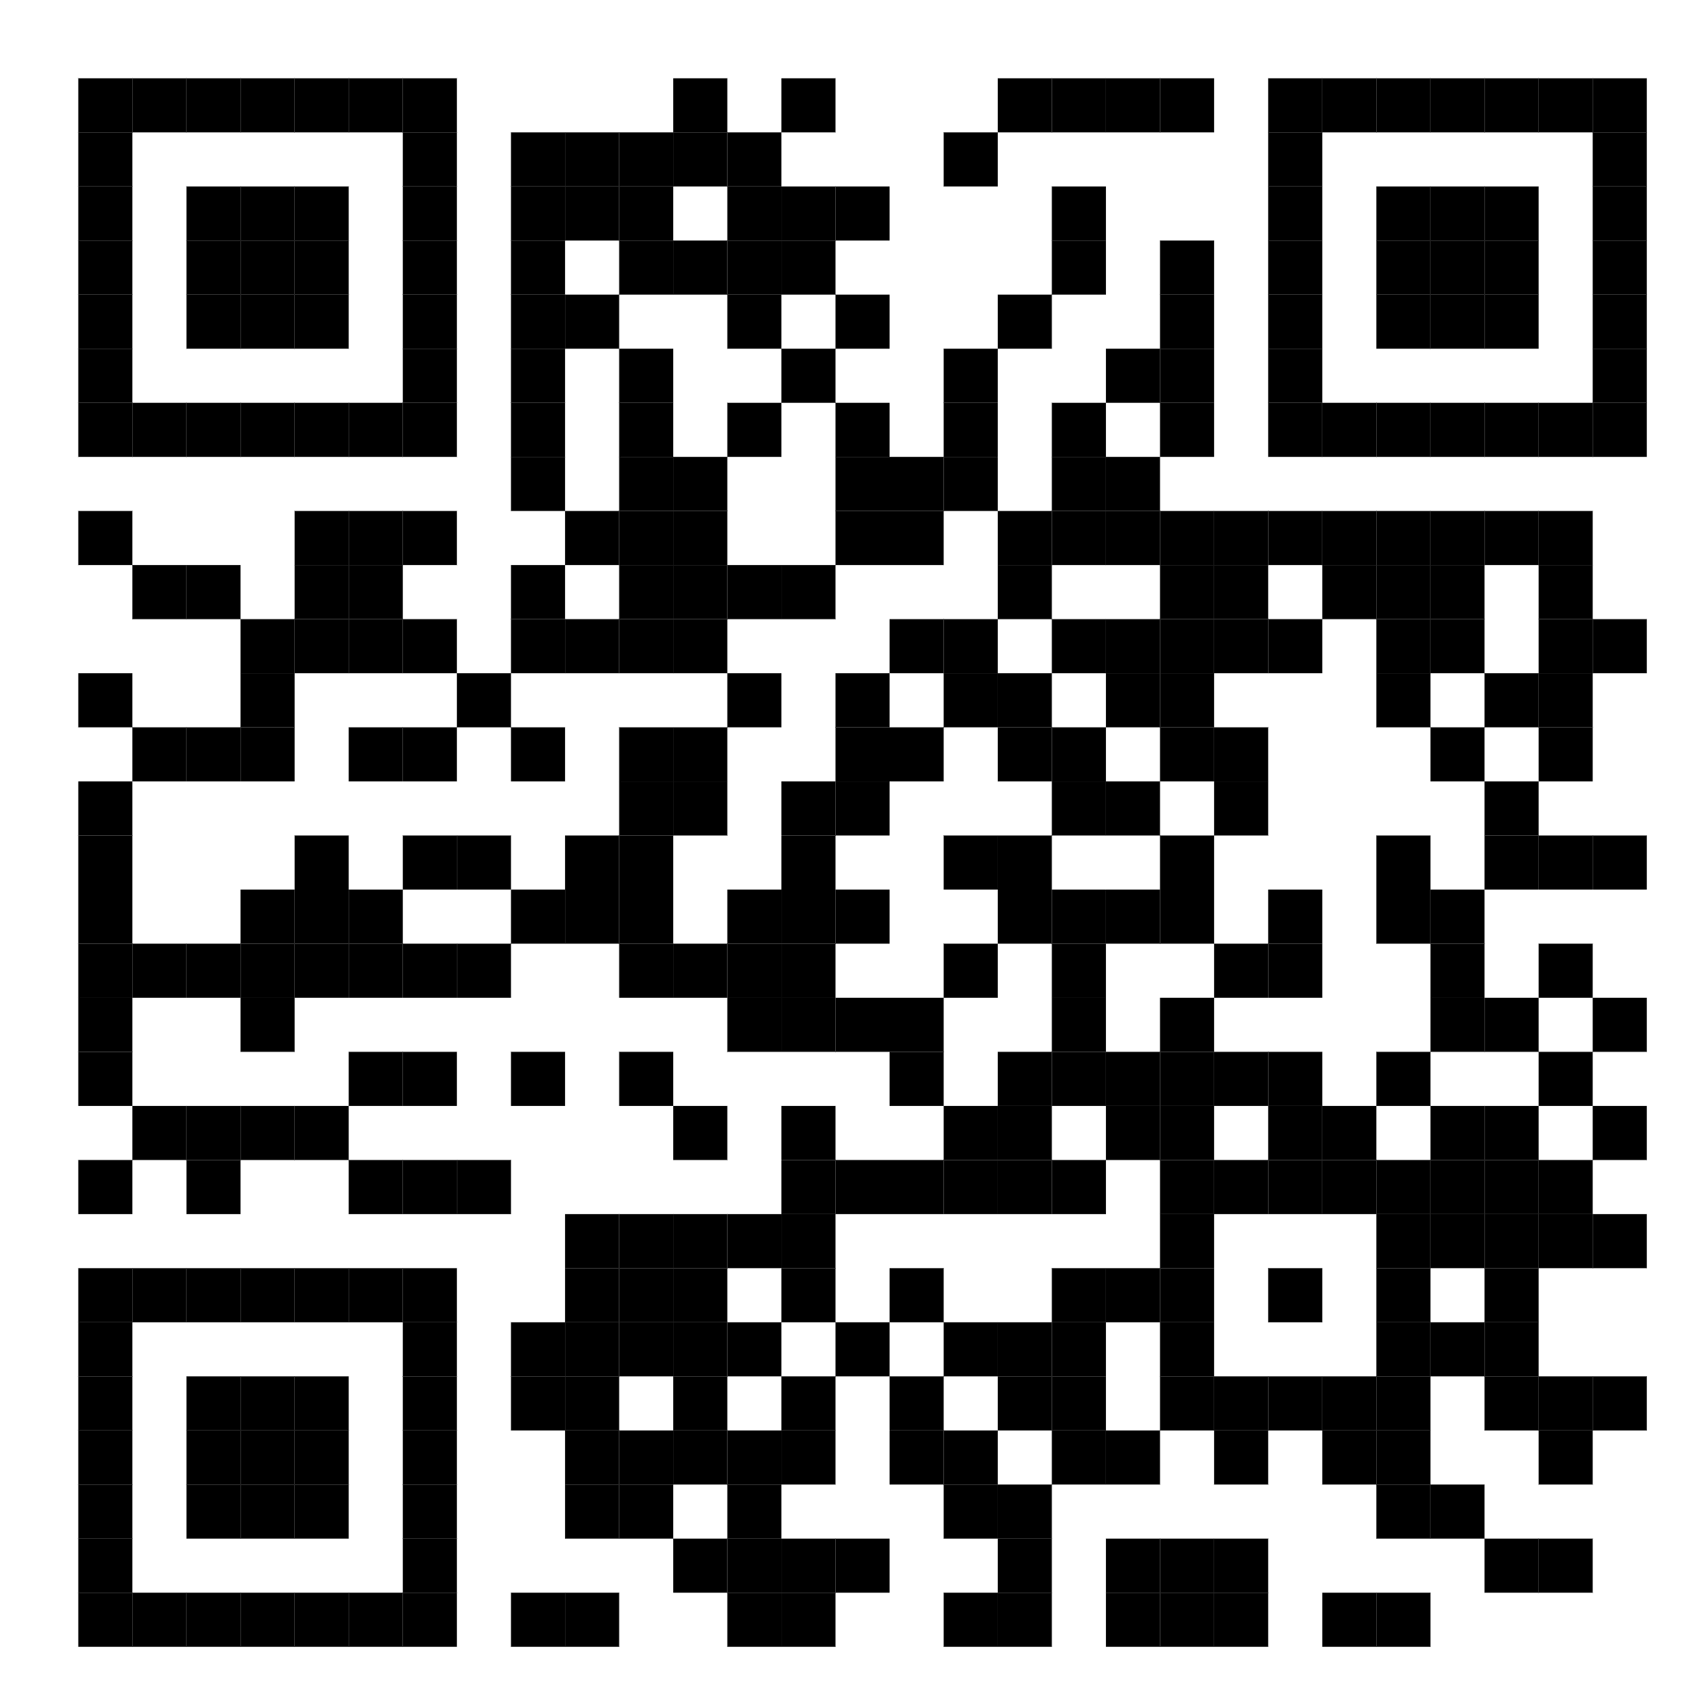
VALUABLE RESOURCES
“Clean Energy Economy” cleanenergy.gov https://www.whitehouse.gov/cleanenergy/?utm_source=link
Rewiring America
https://www.rewiringamerica.org/
Iowa Environmental Council
https://iafederalfunding.org/
Johnson Clean Energy District
https://johnsoncleanenergydistrict.org/
craig.r.mosher@gmail.com

Slide 25
What can you do at your agency?
Basic: LED bulbs, thermostats, pipe/duct sealing
Air sealing windows & doors, age of furnaces, A/C, water heaters, refrigerators
Insulation, windows & doors
Consider solar panels
Notes:
1. SSim (1) Simple, Do It Yourself Checklist (2) Energy coaching (3) Professional Audit Make Simple, Quick ‘Repairs to Cracks and Gaps in Walls, Windows, and Doors Prioritize Needed Upgrades and Develop a Multi-Year Plan before Appliances Fail

Slide 26
Thank you!
johnsoncleanenergydistrict.org
craig.r.mosher@gmail.com

